Slide 1
COMP0005 – ALGORITHMS 3. Search Algorithms
Prof Licia Capra
Dept of Computer Science

Slide 2
CONTENT
Symbol Table
Binary Search Tree
Balanced Search Tree
Hash Table

Slide 3
SEARCH PROBLEM
Application | Goal of Search | Key | Value
Dictionary | Find a definition | Word | Definition
Book Index | Find relevant pages | Term | List of page numbers
Web Search | Find relevant web pages | Keyword | List of URLs
File System | Find file on disk | Filename | Location on disk
File Share | Find song to download | Name of song | URL
Financial account | Process transactions | Account number | Transaction details
… | … | … | …

Slide 4
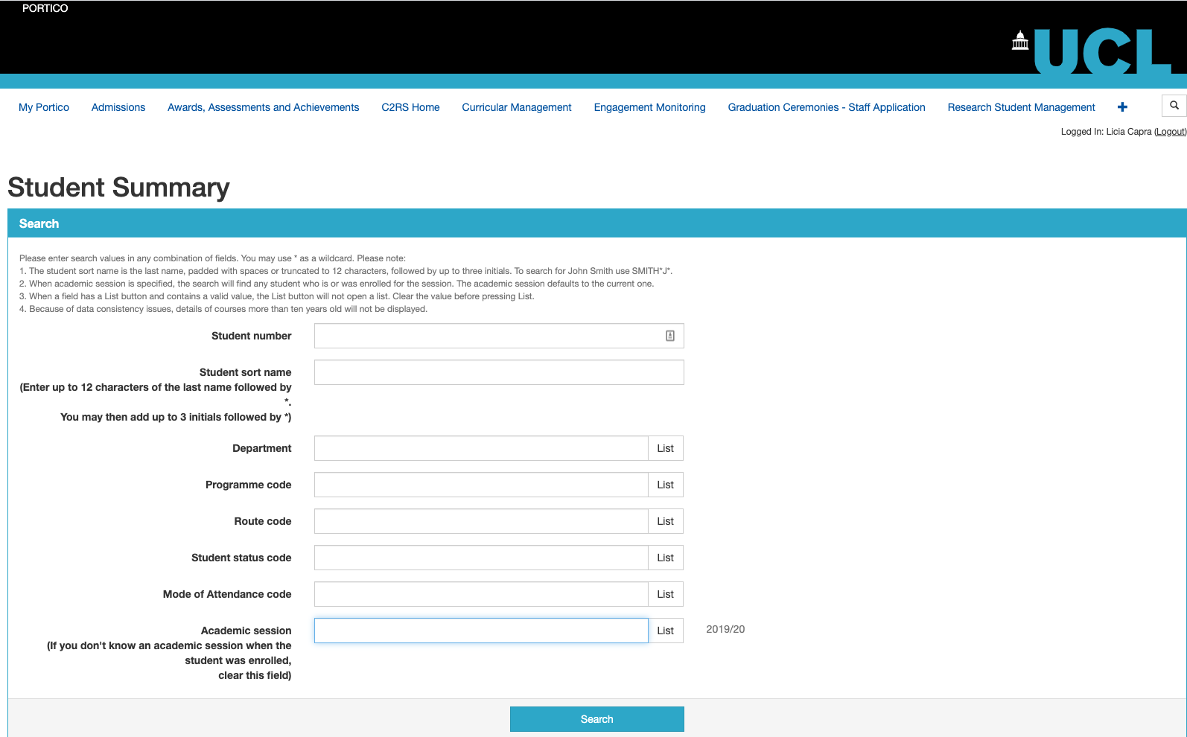
SEARCH PROBLEM
Example: search student’s records in Portico
key

Slide 5
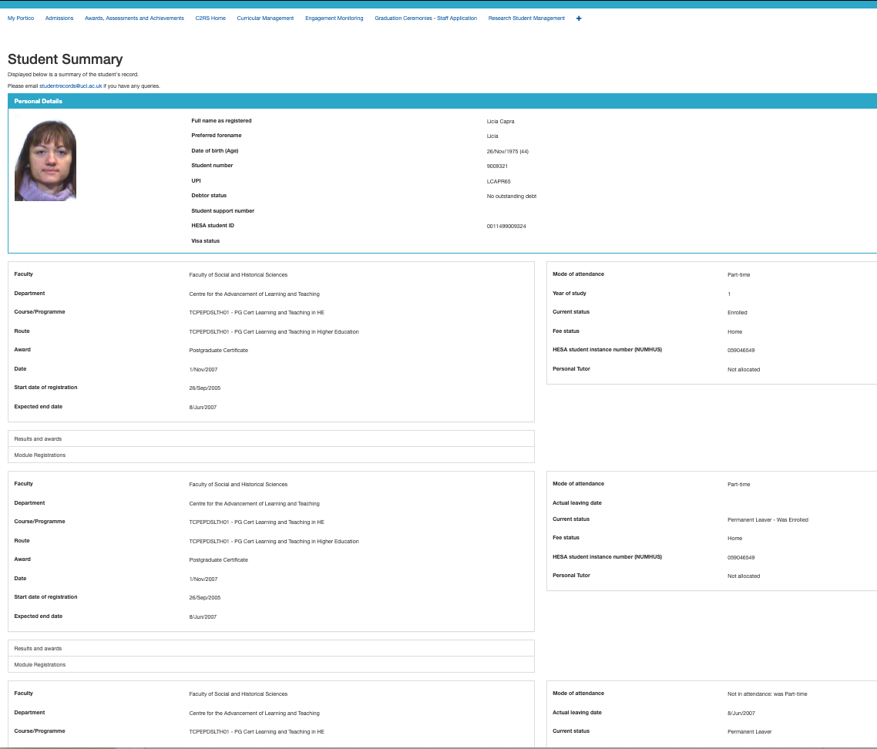
SEARCH PROBLEM
Example: search student’s records in Portico
value

Slide 6
CONTENT
Symbol Table
Binary Search Tree
Balanced Search Tree
Hash Table

Slide 7
SYMBOL TABLE
Abstract data type to handle key-value pairs
Also known as associative array, dictionary, or map
Basic operations
put(key, value): Insert a value with a specified key
get(key): Given a key, search for the corresponding value
Key | Value
UCL | https://www.ucl.ac.uk/
Princeton | https://www.princeton.edu/

Slide 8
SYMBOL TABLE
Abstract data type to handle key-value pairs
Also known as associative array, dictionary, or map
Basic operations
put(key, value): Insert a value with a specified key
get(key): Given a key, search for the corresponding value
Key | Value
Merge sort | [270, 288]
Symbol table | [360,424, 513]

Slide 9
SYMBOL TABLE
Common assumptions
Keys are unique
Values are not null
Keys have a total order relation:
Antisymmetry: if a ≤ b and b ≤ a then a=b
Transitivity: if a ≤ b and b ≤ c then a ≤ c
Totality: a ≤ b or b ≤ a

Slide 10
Elementary implementation of symbol table
Linked List & Sequential Search
Data structure: unordered linked list of key-value pairs
Get(key): scan through the list until a matching key is found
Put(key, value): scan through the list
If a matching key is found, replace the associated value
If a matching key is not found, add the (key, value) pair to the front of the list
Cost: N for both get (search) and put (insert)
S
v₁
E
v₂
A
v₃
R
v₄
C
v₅
H
v₆
key
value

Slide 11
Elementary implementation of symbol table
Ordered Array & Binary Search
Data structure: ordered array of keys, plus another array of their associated values
Key/value pairs
S
v₁
0 | 1 | 2 | 3 | 4 | 5
Keys[]
A | C | E | H | R | S
E
v₂
0 | 1 | 2 | 3 | 4 | 5
A
v₃
Values[]
v₃ | v₅ | v₂ | v₆ | v₄ | v₁
R
v₄
C
v₅
H
v₆

Slide 12
Elementary implementation of symbol table
Ordered Array & Binary Search
Get(key): binary search on Keys[], then lookup in Values[]
Put(key, value): binary search on Keys[]
If a matching key is found, replace the associated value
If a matching key is not found, use insertion sort (need to shift all greater key/value pairs over)
Cost: lg N for get (search), N for put (insert)
0 | 1 | 2 | 3 | 4 | 5
Keys[]
A | C | E | H | R | S
get(R)
lo | hi | m
0 | 5 | 2
3 | 5 | 4
0 | 1 | 2 | 3 | 4 | 5
Values[]
v₃ | v₅ | v₂ | v₆ | v₄ | v₁
return Values[4]→ v₄

Slide 13
Elementary implementation of symbol table
Ordered Array & Binary Search
Get(key): binary search on Keys[], then lookup in Values[]
Put(key, value): binary search on Keys[]
If a matching key is found, replace the associated value
If a matching key is not found, use insertion sort (need to shift all greater key/value pairs over)
Cost: lg N for get (search), N for put (insert)
0 | 1 | 2 | 3 | 4 | 5
Keys[]
A | C | E | H | R | S
get(L)
lo | hi | m
0 | 5 | 2
3 | 5 | 4
3 | 3 | 3
0 | 1 | 2 | 3 | 4 | 5
Values[]
v₃ | v₅ | v₂ | v₆ | v₄ | v₁
return null

Slide 14
Elementary implementation of symbol table
Ordered Array & Binary Search
Get(key): binary search on Keys[], then lookup in Values[]
Put(key, value): binary search on Keys[]
If a matching key is found, replace the associated value
If a matching key is not found, use insertion sort (need to shift all greater key/value pairs over)
Cost: lg N for get (search), N for put (insert)
0 | 1 | 2 | 3 | 4 | 5
0 | 1 | 2 | 3 | 4 | 5 | 6
Keys[]
A | C | E | H | R | S
A | C | E | H | L | R | S
put(L, v7)
0 | 1 | 2 | 3 | 4 | 5 | 6
0 | 1 | 2 | 3 | 4 | 5
Values[]
v₃ | v₅ | v₂ | v₆ | v₄ | v₁
v₃ | v₅ | v₂ | v₆ | v₇ | v₄ | v₁

Slide 15
CONTENT – RECAP
Symbol Table
Binary Search Tree
Balanced Search Tree
Hash Table

